Slide 1
Bus Reservation Management System

Slide 2
TABLE OF CONTENTS
01
03
02
04
Overview
Working
Benefits
Conclusion

Slide 3
—Linus Torvalds
“Talk is cheap, show me the code”

Slide 4
01
OVERVIEW

Slide 5
In an ever-advancing world, travelling becomes one of the most important aspect in life. The travel industry is evolving at a constant speed every day, as the industry evolves it needs digitalisation to eliminate third party influence and make ticket booking much simpler. This project can further be used as mobile and desktop application. The project “Bus Reservation System” is done by C language. This system’s key features are – Login system, booking the ticket, cancelation of the booked ticket, viewing bus status. This reservation system is straightforward and clean, making it easy for users to learn, use and navigate. The logic of this reservation system is designed to meet the modern purposes.

Slide 6
Benefits
Reduces Manpower
Provides flexibility
Keeping record of scores more accurately
Better performance
Faster perfomance
Increases efficiency

Slide 7
Working
The Bus Reservation Management System works on the following algorithm –
Algorithm
The algorithm for “Bus Reservation System” as follows:
Step 1: Enter Username [user]
Step 2: Enter Password [user]
Step 3: Choose any option from the main menu
Step 4: View the list of busses
Step 5: Go for booking the ticket
Step 6: After booking the ticket, check the bus status
Step 7: If the user wishes to cancel the ticket, he/she can proceed to cancel the ticket
Step 8: Exit.

Slide 8
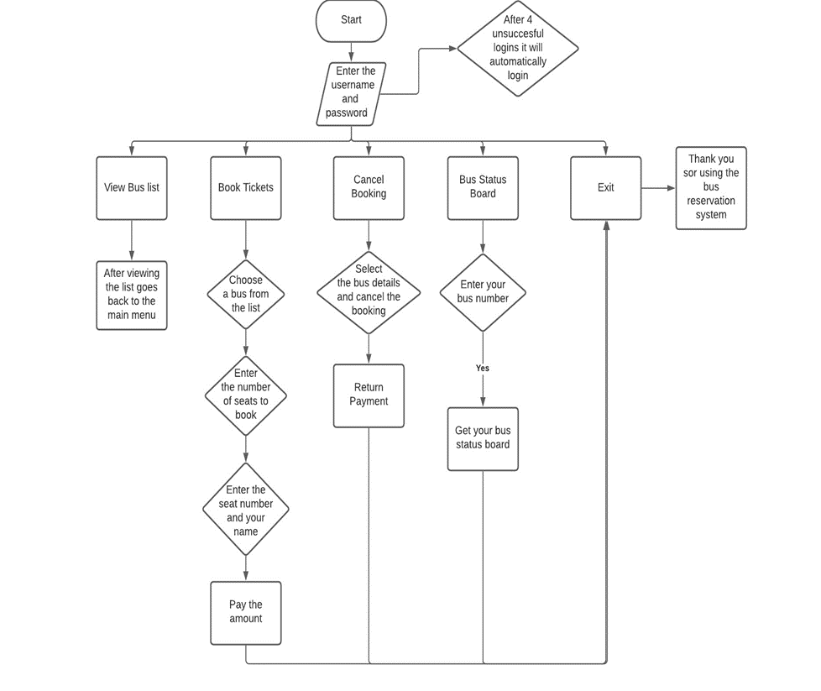

Slide 9
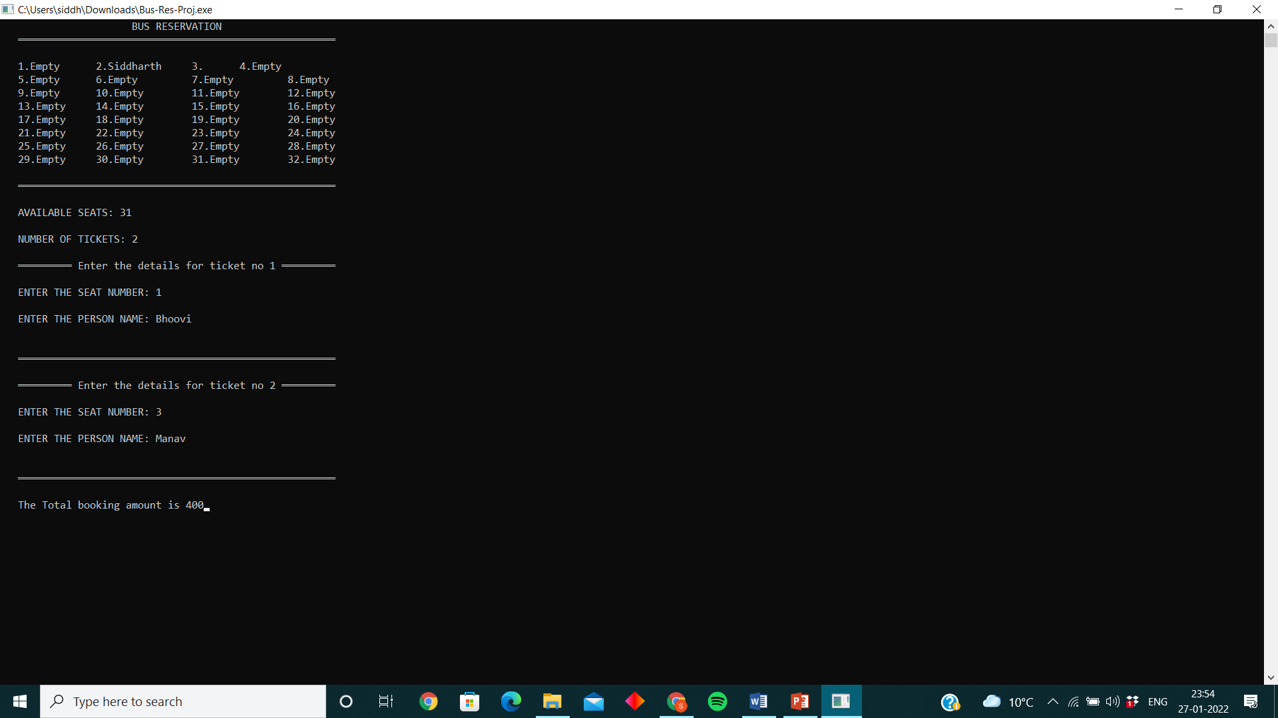
DEMO

Slide 10
Conclusion
This Bus Reservation Management system will serve as a useful approach for the person to book bus tickets efficiently.
It reduces the time taken by the person.
This management system is user friendly.
It reduces manual work.

Slide 11
Thank You
.

